Slide 1

3D Inspection Rover
Team members:
Chris Dumont
Dalton Hines
Felipe Villegas
Celeste Waters

Slide 2
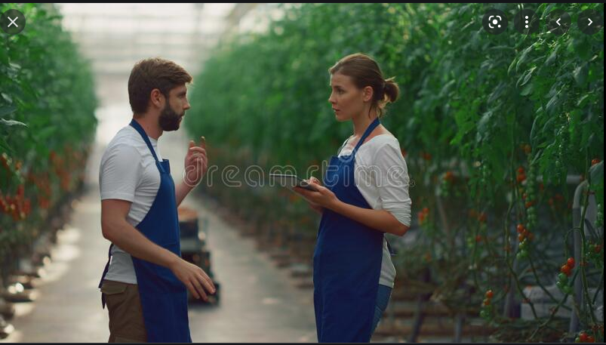
The Issue is…
Tomato identification is a time-consuming process
There needs to be a way to reduce man hours, as greenhouse size increases.
Notes:
Howdy!
The problem we have been presented with is improving how tomatoes are sorted before being picked. Currently, the only way this is done is by having people walk throughout a greenhouse and manually recording each tomato either on a tablet or pen and paper. This is fine with small operations, but as greenhouse size increases the number of man hours increases exponentially.

Slide 3
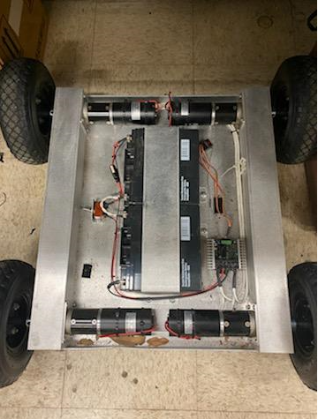
Our Solution is…
Create a rover that will
Autonomously navigate a greenhouse
Take pictures of all tomatoes
Classify every tomato by ripe/unripe/sick
Store this information and create useful data for farmer
Notes:
The solution we have to this problem is to create a rover that will autonomously navigate the greenhouse and stop at each plant so that the on board camera can then take pictures of the it. These images are then classified through a machine learning program and sorted in the categories ripe/unripe and sick. The sorted images will then be uploaded to a database that will create useful charts and graphics that the farmer can use to efficiently pick/remove tomatoes.

Slide 4
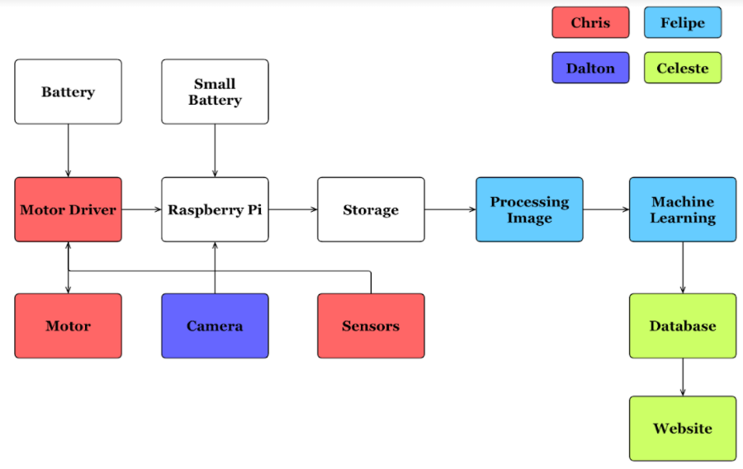
Diagram of subsystems and interface
Notes:
Here we can see each subsystem separated by its owner.
In white we have systems that are being used by more than one person.
Myself has navigation,
Dalton has Camera Positioning and image capturing
Felipe has Tomato state recognition and machine learning
And Celeste has Data Filtering and Cloud storage

Slide 5
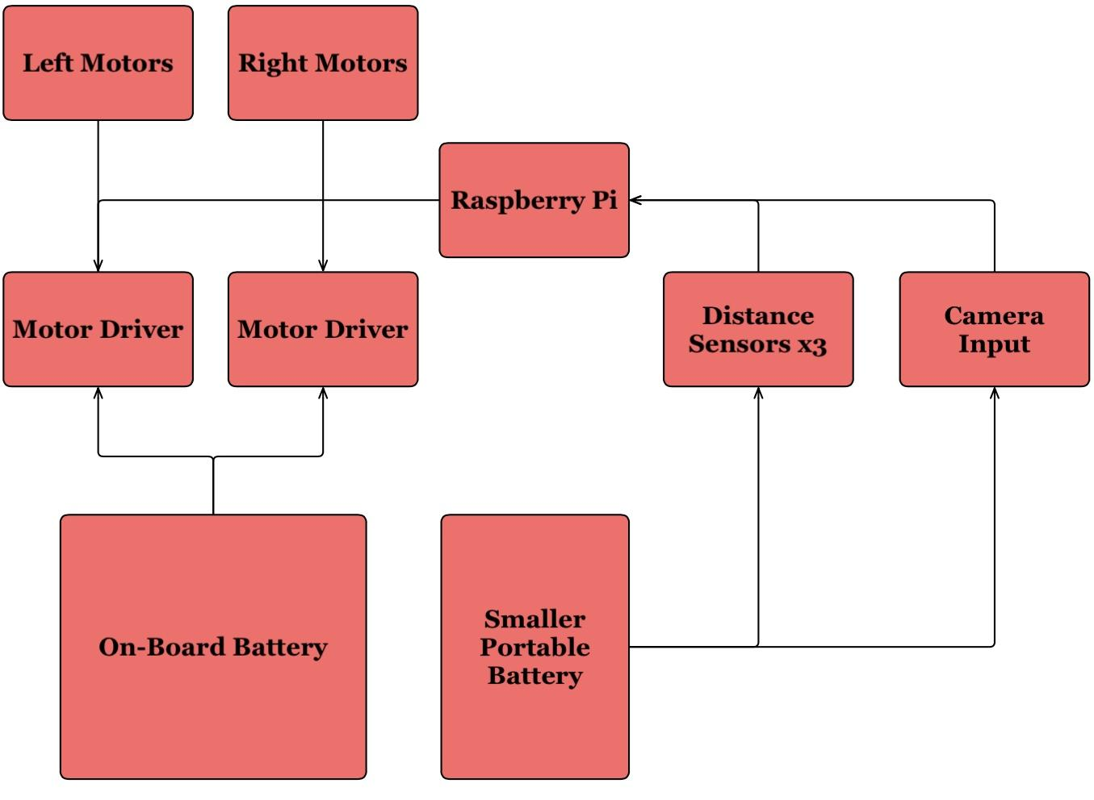
Navigation Subsystem
On Board Battery:
Motor Drivers
Motors
Auxiliary Power:
Raspberry Pi
Distance Sensors
Camera
Notes:
Here we have a block diagram of how the navigation subsystem sends power and signals. As well as showing where each part gets its power from.
The on board battery pack which consists of 2 12 volt 18 aH batteries that will supply power through the motor drivers to the motors. It is set up such that the two motors on the left are controlled in unison and same for the right motors.
There will also be an auxiliary power source that is a 5 volt 6 aH battery. I chose to do this because the motors will be pulling a lot of power and I want the system to be able to run as long as possible. The Pi/sensors/ and camera all pull low power. The distance sensors pull less than 2mA each and the pi rarely pulls more than 1 amp. Using the separate battery will not only increase the life of the system, but also removes the need for a converter to be made that would reduce the 24 volts down to 5 so that the smaller systems don’t get fried.
The motor driver is actually just one Sabertooth 2x25, I chose to have it split on the image here because it is easier to follow and still portrays the same information. The driver is capable of driving two motors separately, which is exactly what the application requires.
I also chose to have 3 distance sensors, 1 facing forward, and two facing 45 degrees away from that. I believe this will provide the most useful information when it comes to the task at hand.
I chose a Raspberry Pi partly because I already had one, but also because it is capable of supplying the PWM necessary for driving the two sets of motors as well as having enough GPIO pins to read every sensors and has the necessary computing power to process and react to all the inputs it will be given from the sensors and camera in real time.
In operation, the Pi will be taking inputs from the distance sensors and camera, processing them, and then creating outputs to signal the motor drivers on what to do. Be it continue forward, stop, or turn. The distance sensors will be used as obstacle detection. This is important for 2 reasons, First so that the rover doesn’t run over a plant, and second to detect if something, or someone is in the path so that the rover can stop and go around the object or wait for it to be moved so that the rover does not get damaged. Simultaneously, the Pi will be taking inputs from the camera to determine how far away from the next plant it is and progressing to it, so that Dalton’s subsystem may begin it’s work.

Slide 6
Navigation Chris Dumont
Accomplishments since the last presentation 20 hrs | Ongoing progress/problems and plans until the next presentation
Completed Testing of distance sensors across multiple materials at distances from 6 inches to 8.5 ft Basic code written for motor control based on distance readings | Mounting Distance sensors Control of motor driver Motor reacting to distance readings accurately Motor reacting to distance to next plant

Slide 7
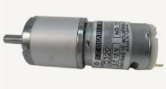
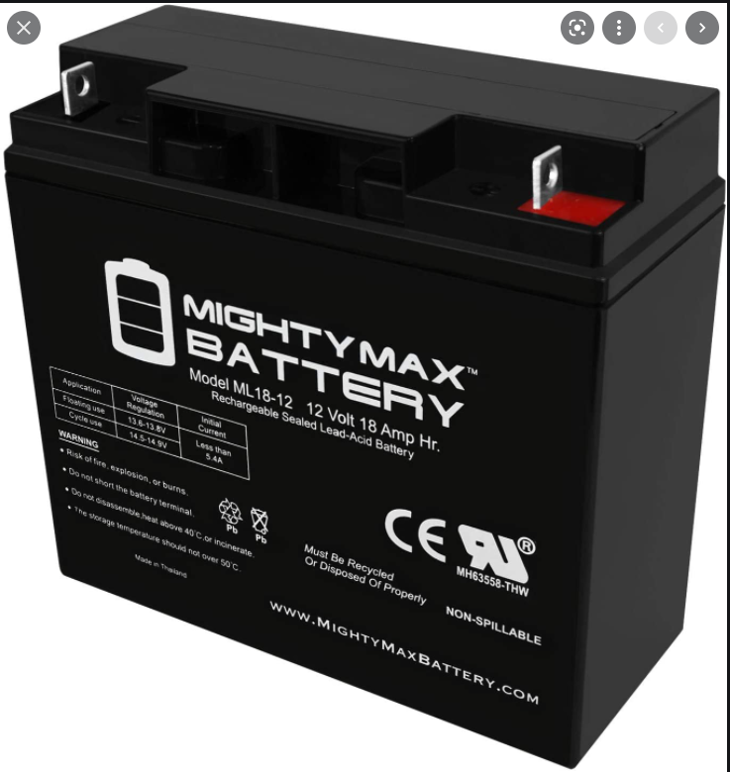
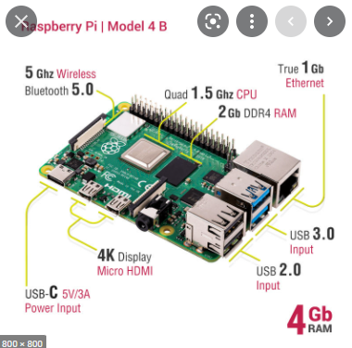
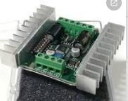
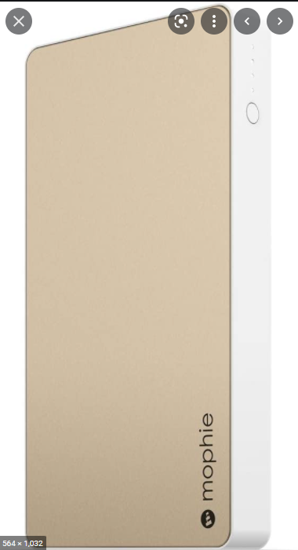
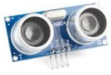
Specifically…
Large Battery x2
12 volt 18 amp hours
Motor x4
24 volt
Raspberry
Pi 4 B
Sabertooth 2x25
Capable of driving 2 motors at 24 volts and 25 amps
Small Battery
5 volt 6 amp hours
Distance Sensor x3
HC-SR04

Slide 8
Why a Pi?
Python has been used heavily in robotics.
32 GPIO Pins, and 2 PWM, perfect for every sensor
Ample Computing power to process all information in real time

Slide 9
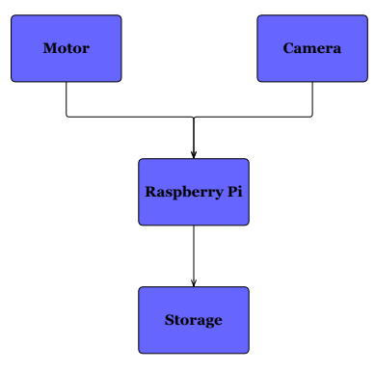
Camera Positioning & Image Taking Subsystem
Image Taking
Sony Dragon Touch action camera
Camera Positioning
Raspberry Pi controls movement
Camera mounted to a gimbal with servo motors for pan/tilt
Mast to increase vertical range

Slide 10
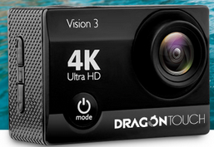
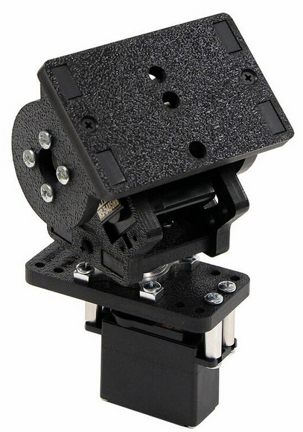
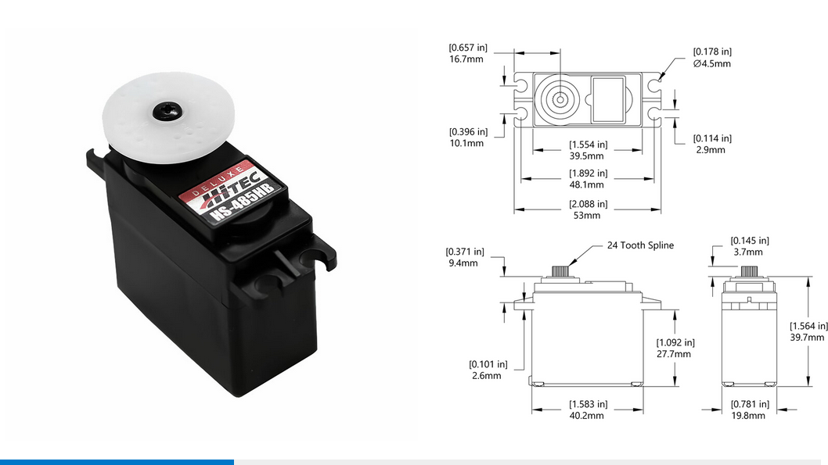
Camera, Gimbal, and Motor
HS-485HB Servo Motor
No Load Speed: .22 sec/60 degrees
Max Rotation: 190 degrees
Stall Torque: 66.6 oz-in
Current Drain (Idle/No-Load): 8 mA/150 mA
Voltage Range: 4.8-6 V
SPT200 Pan and Tilt Kit
Sony Dragon Touch Action Camera

Slide 11
Camera Positioning & Image Taking Dalton Hines
Accomplishments since the last presentation 25 hrs | Ongoing progress/problems and plans until the next presentation
Base code for camera positioning Servo motor movement | Mast movement and construction Gimbal and camera connectivity Control of mast and gimbal together

Slide 12
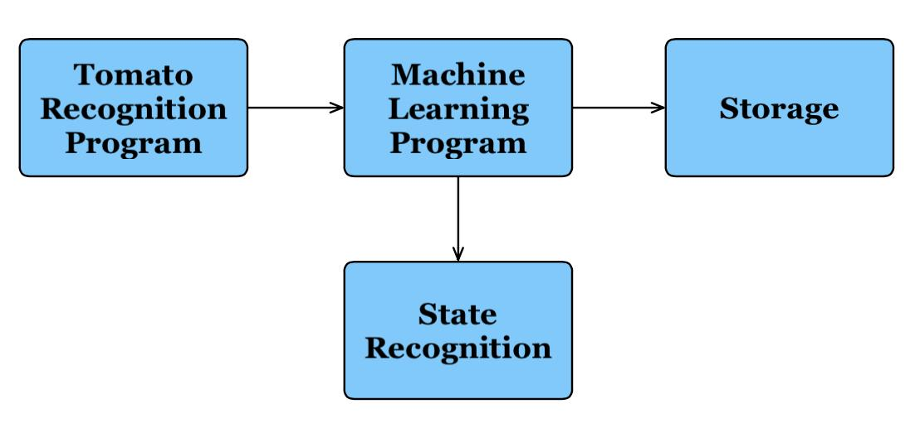
Machine Learning - Ripeness Classification
Recognize a tomato’s ripeness or if it is rotten from an image
Keep track of number of tomatoes and their ripeness or health
CNN Machine Learning Model
Use of Python TensorFLow library

Slide 13
Machine Learning - Tomato Recognition
Locate one or more tomatoes from an image
ML Image Segmentation
Mask R-CNN

Slide 14
Tomato Recognition and Classification Felipe Villegas
Accomplishments since the last presentation 25hrs | Ongoing progress/problems and plans until the next presentation
Image dataset for tomato recognition and classification | Tomato Classification CNN Implementation Tomato Recognition Program Implementation

Slide 15
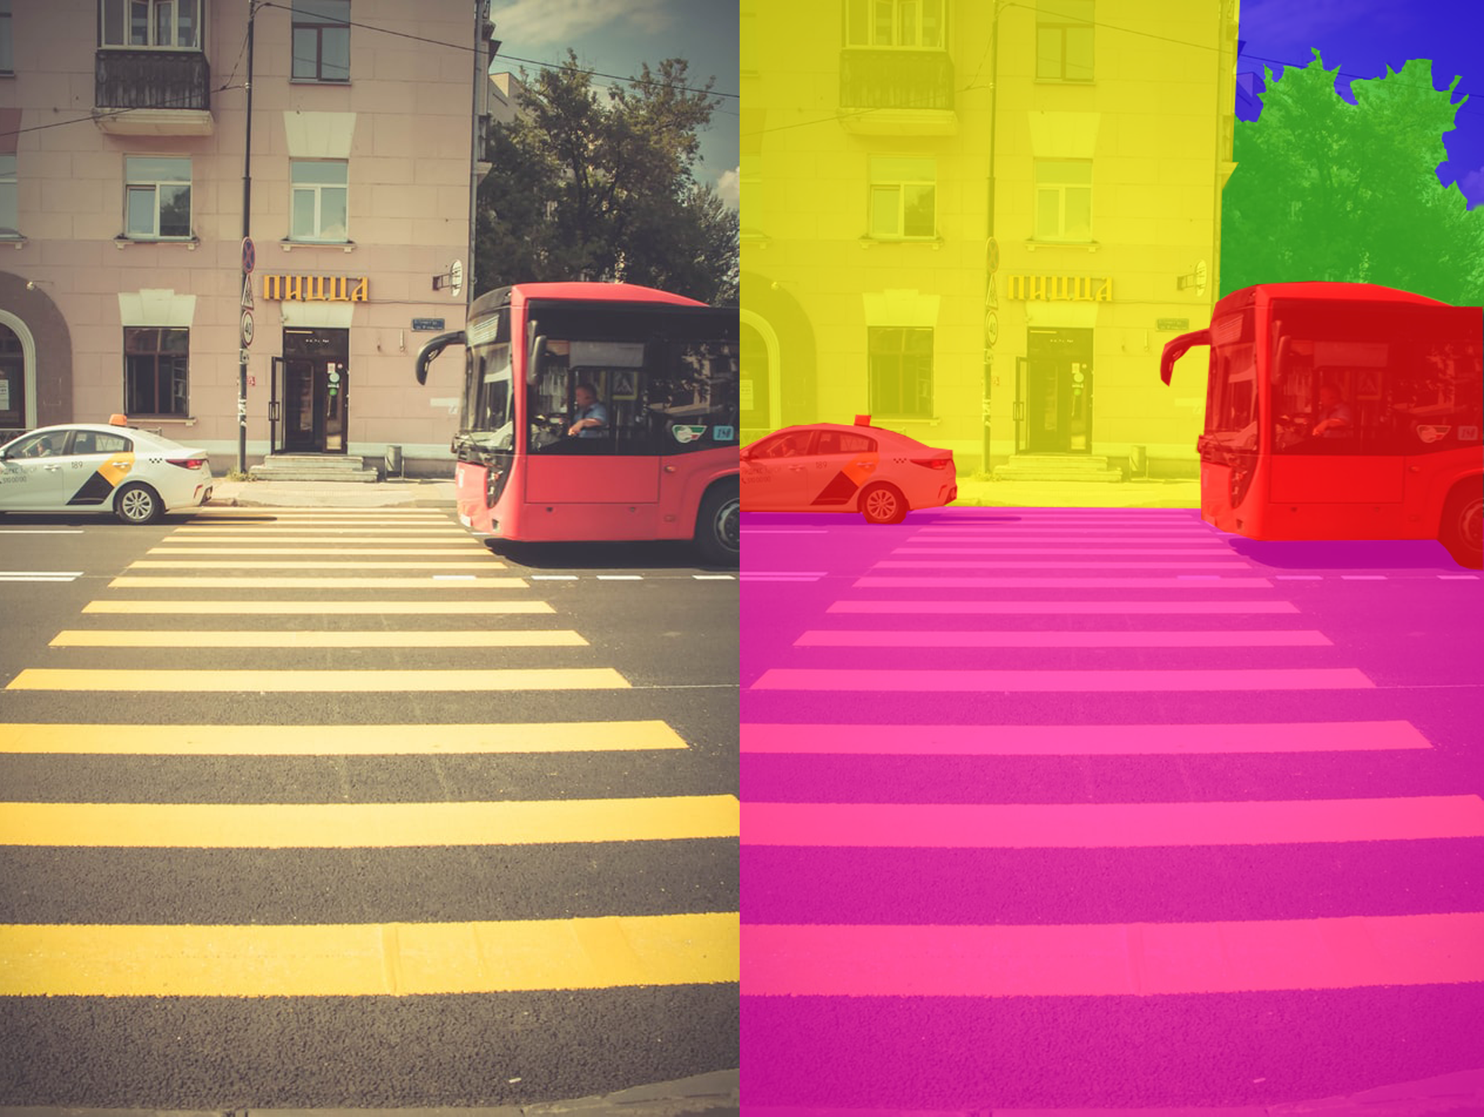
Image Segmentation
Each object of interest has its own mask or “color” associated with it
Source: https://commons.wikimedia.org/wiki/File:Image_segmentation.png

Slide 16
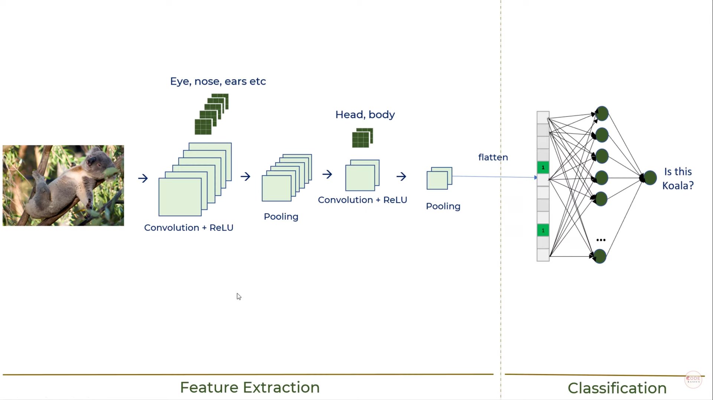
Graphic of CNN Process
2 Main Parts:
Feature Extraction and
Classification
Source: https://www.youtube.com/watch?v=zfiSAzpy9NM&list=PLeo1K3hjS3uu7CxAacxVndI4bE_o3BDtO&index=23

Slide 17
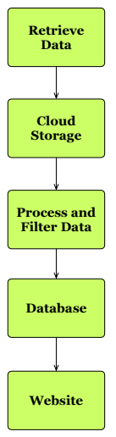
Database, Website, and Cloud Computing
Cloud computing services
Microsoft Azure
Database
MongoDB: show key capabilities
Limited Data
Website will display expected yield, percentage of ripeness, and health factors of the plant

Slide 18
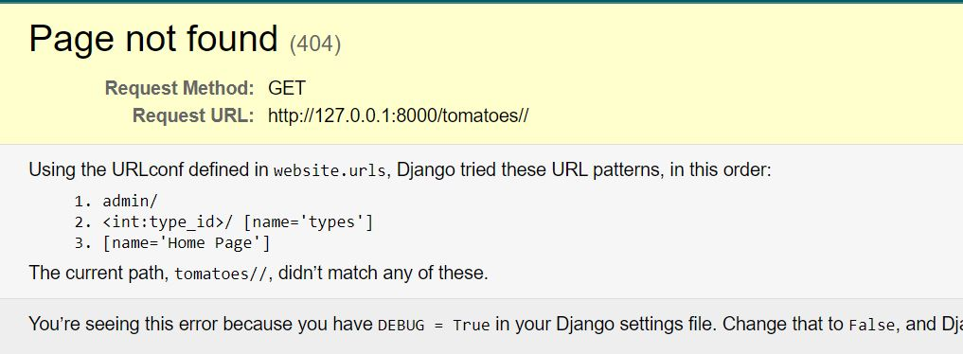
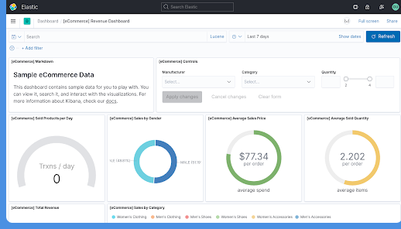
Database, Website, Cloud Computing Celeste Waters
Accomplishments since the last presentation 35 hrs | Ongoing progress/problems and plans until the next presentation
Clickable Webpage Error pages (404) Authentication Admin page (login) | Populated database (small) Graphed data Organized website

Slide 19
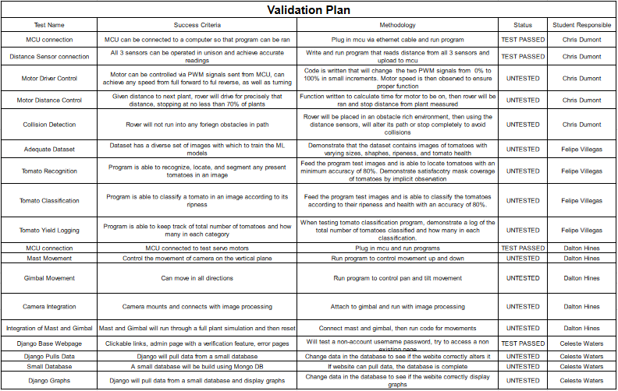
Validation Plan

Slide 20
Part order status
Part Description | Status (order approved/order placed/part received)
Voltage Shifter (3 of them) | Received
SPT200 Pan and Tilt Kit (C24T Spline) | Ordered
HS-485HB Servo (2 of them) | Ordered
Direct Drive Pan Mount | Ordered

Slide 21
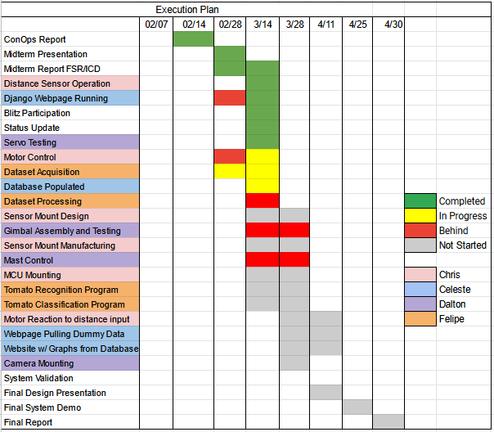
Execution Plan

Slide 22
Questions?

